Slide 1
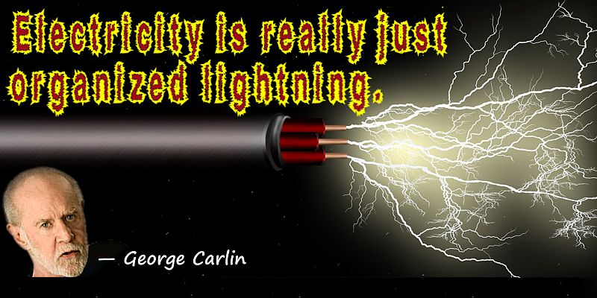

Slide 2
Electricity
Is charge flowing along a closed path.
Flows along conductive materials.
Convertible to/from other forms of energy (mechanical, heat, light, chemical).
Electronics is the science of controlling electricity.

Slide 3
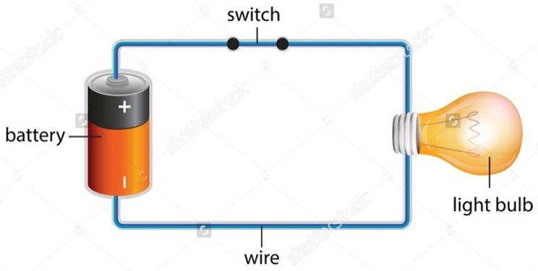
Simple Electrical Circuit
Chemical reaction in battery produces electrical charge, which flows along the wire, producing light and heat energy inside bulb.

Slide 4
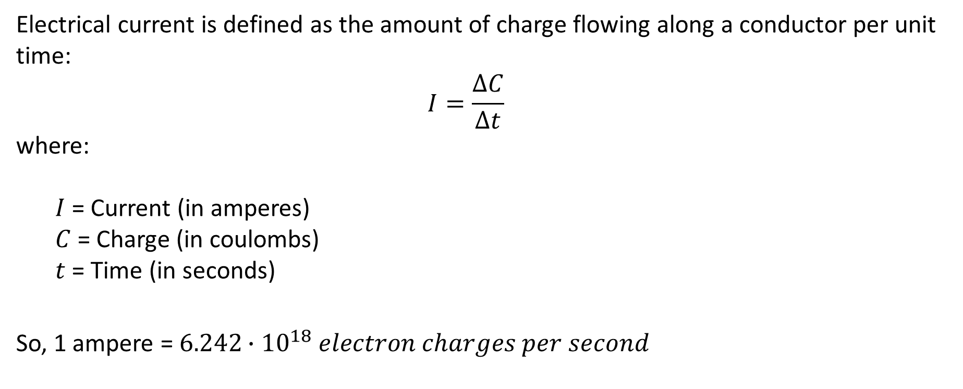
Current Flow
Electrical current is defined as the amount of charge flowing along a conductor per unit time:
$$I=\frac{∆C}{∆t}$$
where:
$I$ = Current (in amperes)
$C$ = Charge (in coulombs) $t$ = Time (in seconds)
So, 1 ampere = $6.242∙{10}^{18} electron charges per second$

Slide 5
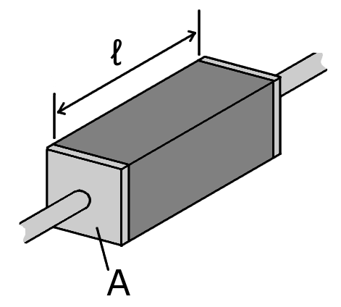
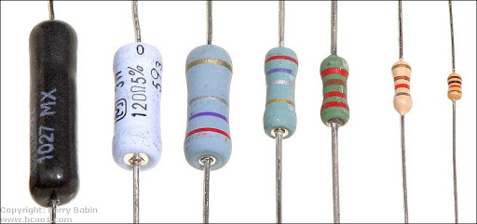
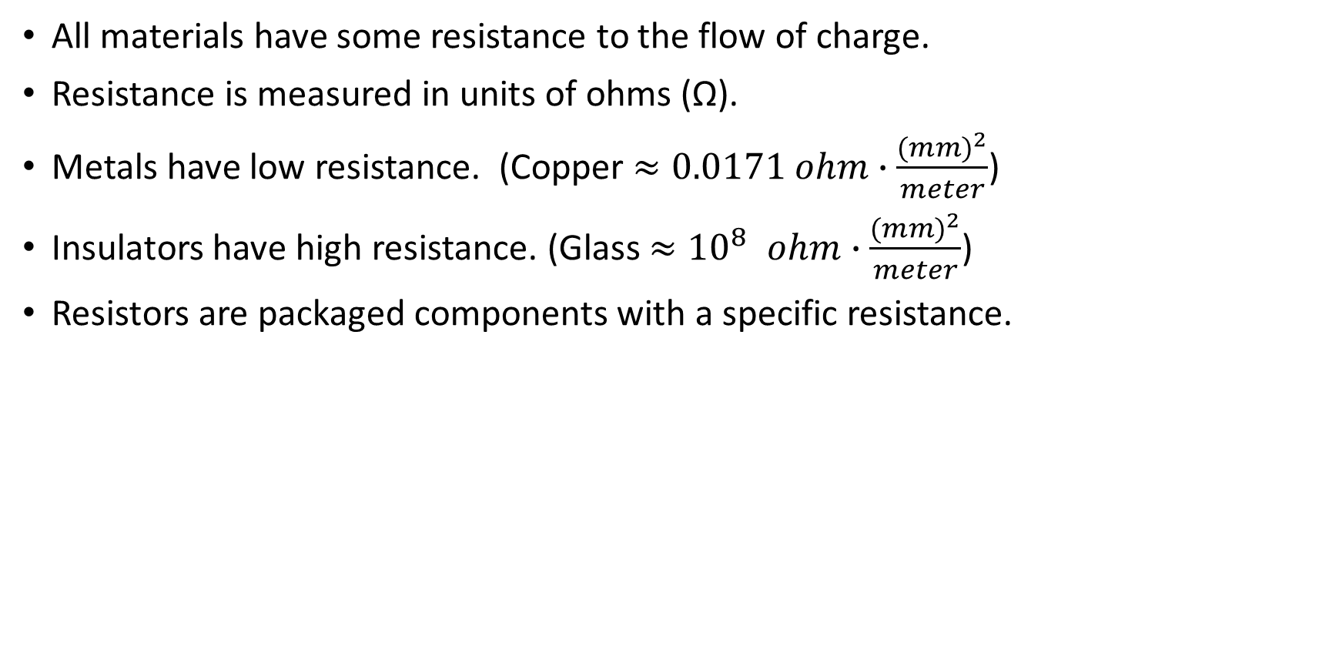
Resistance
All materials have some resistance to the flow of charge.
Resistance is measured in units of ohms (Ω).
Metals have low resistance. (Copper $≈0.0171 ohm∙\frac{{(mm)}^{2}}{meter}$)
Insulators have high resistance. (Glass ${≈10}^{8} ohm∙\frac{{(mm)}^{2}}{meter}$)
Resistors are packaged components with a specific resistance.

Slide 6
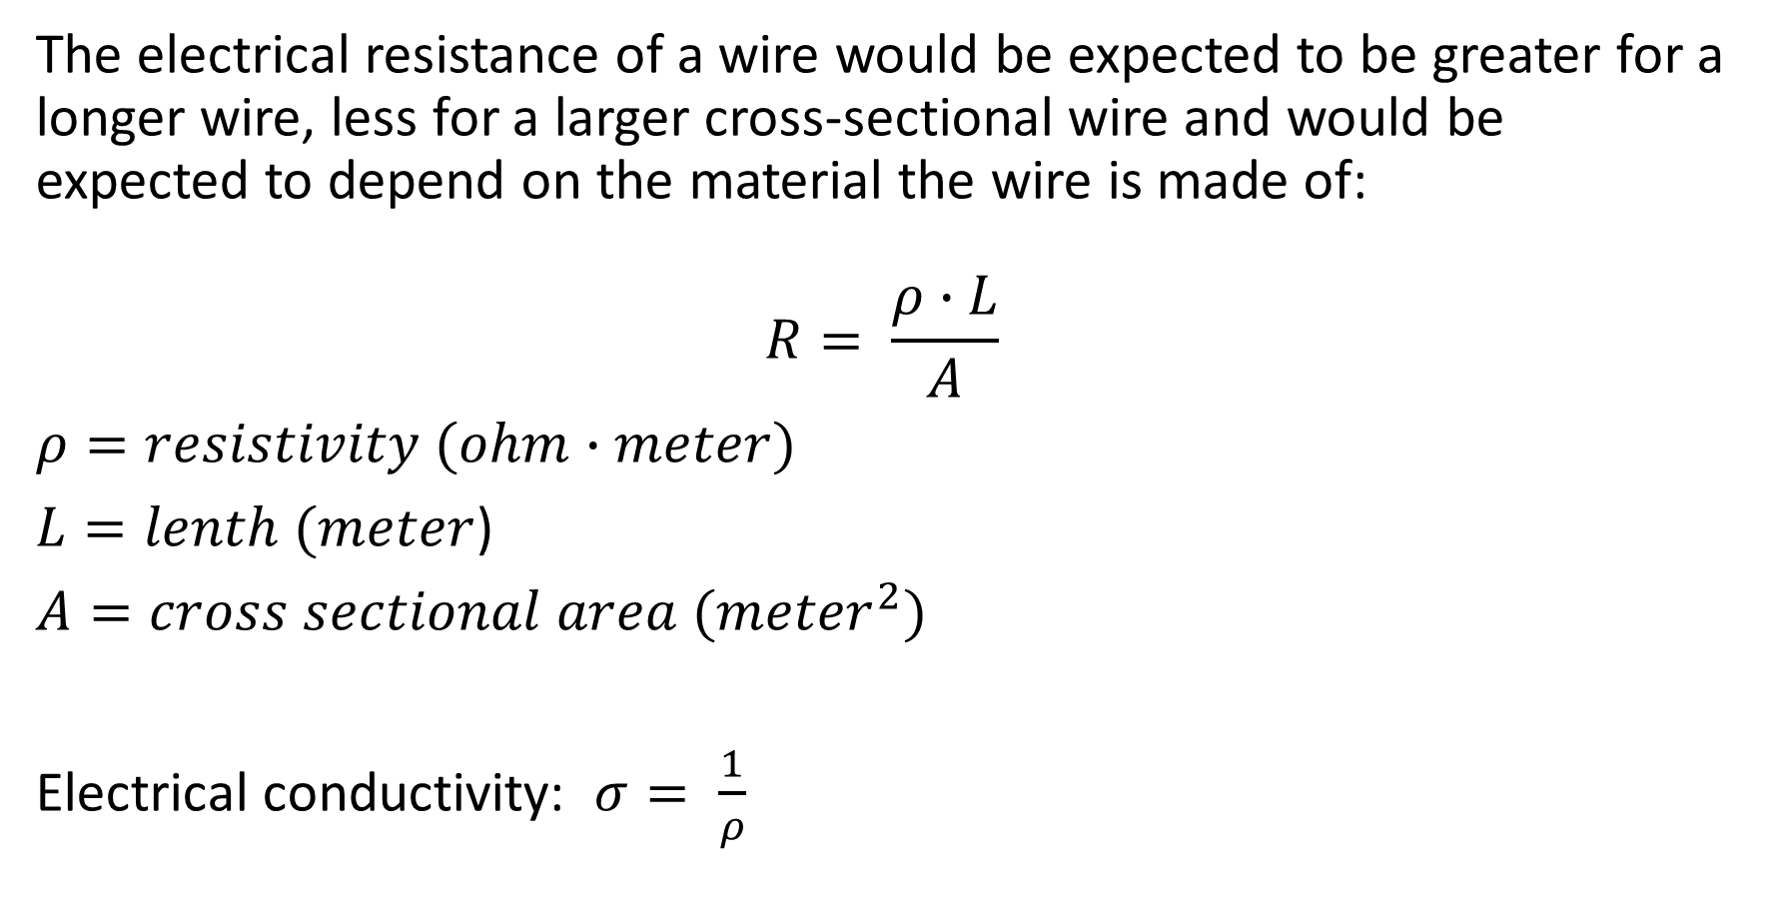
Resistivity and Conductivity
The electrical resistance of a wire would be expected to be greater for a longer wire, less for a larger cross-sectional wire and would be expected to depend on the material the wire is made of:
$$R= \frac{ρ∙L}{A}$$
$ρ=resistivity (ohm∙meter)$
$L=lenth (meter$)
$A=cross sectional area ({meter}^{2})$
Electrical conductivity: $σ= \frac{1}{ρ}$

Slide 7
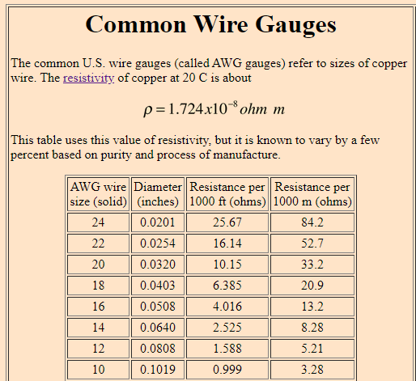

Slide 8
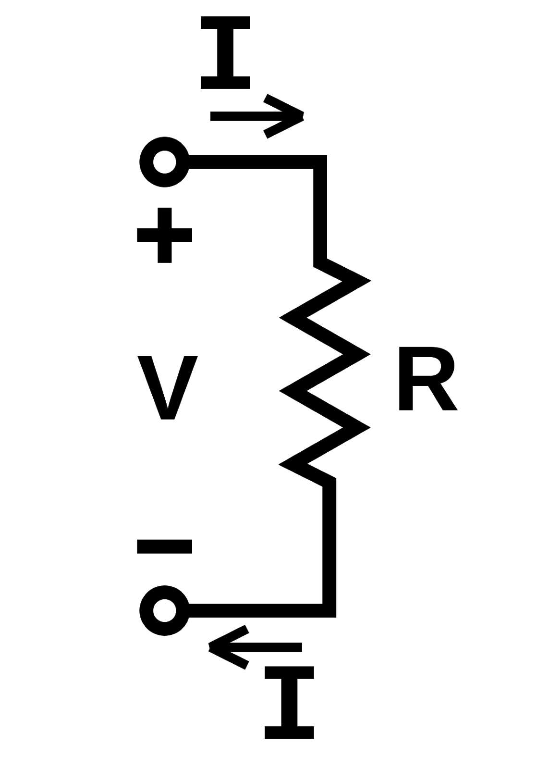
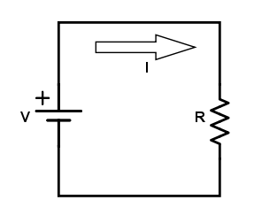
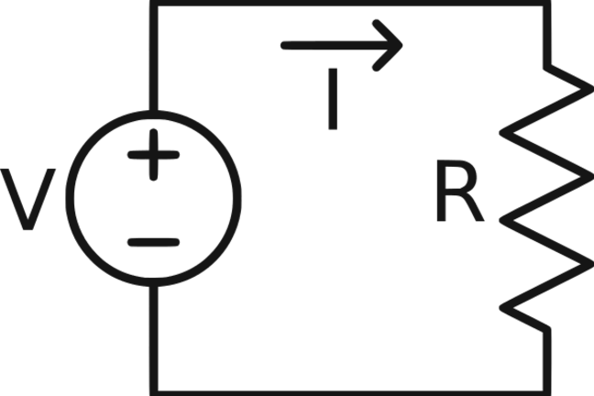
Circuit Schematics

Slide 9
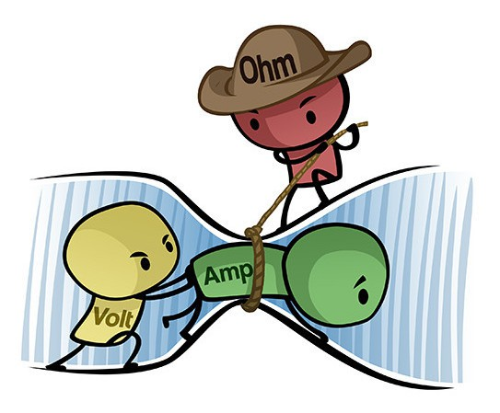
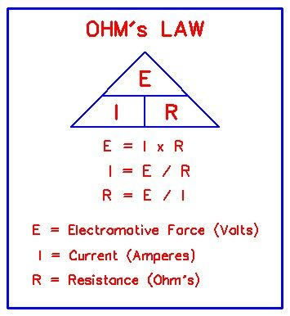
Ohm’s Law

Slide 10

Ohm’s Law Example
The battery voltage is 6.0 volts. The current is measured to be 480 ma (milliamperes). What is the resistance of the glowing filament?
R = E / I = 6.0 / 0.480 = 12.5 ohms

Slide 11
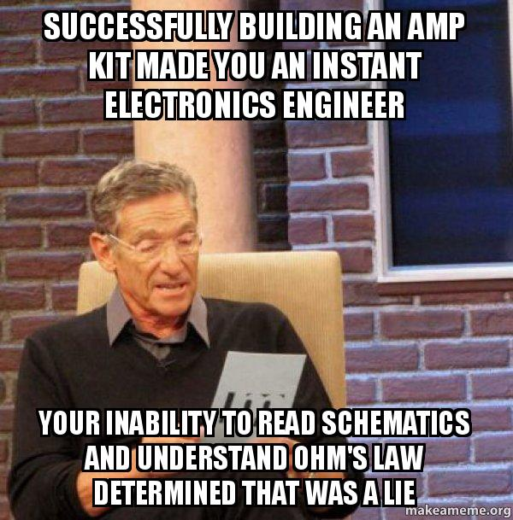
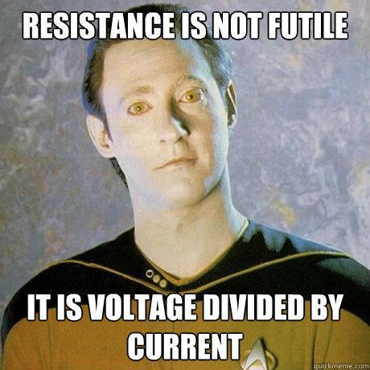
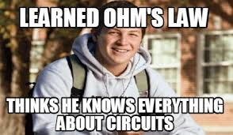
Ohm’s Law: Points to Ponder

Slide 12
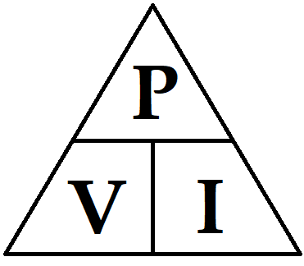
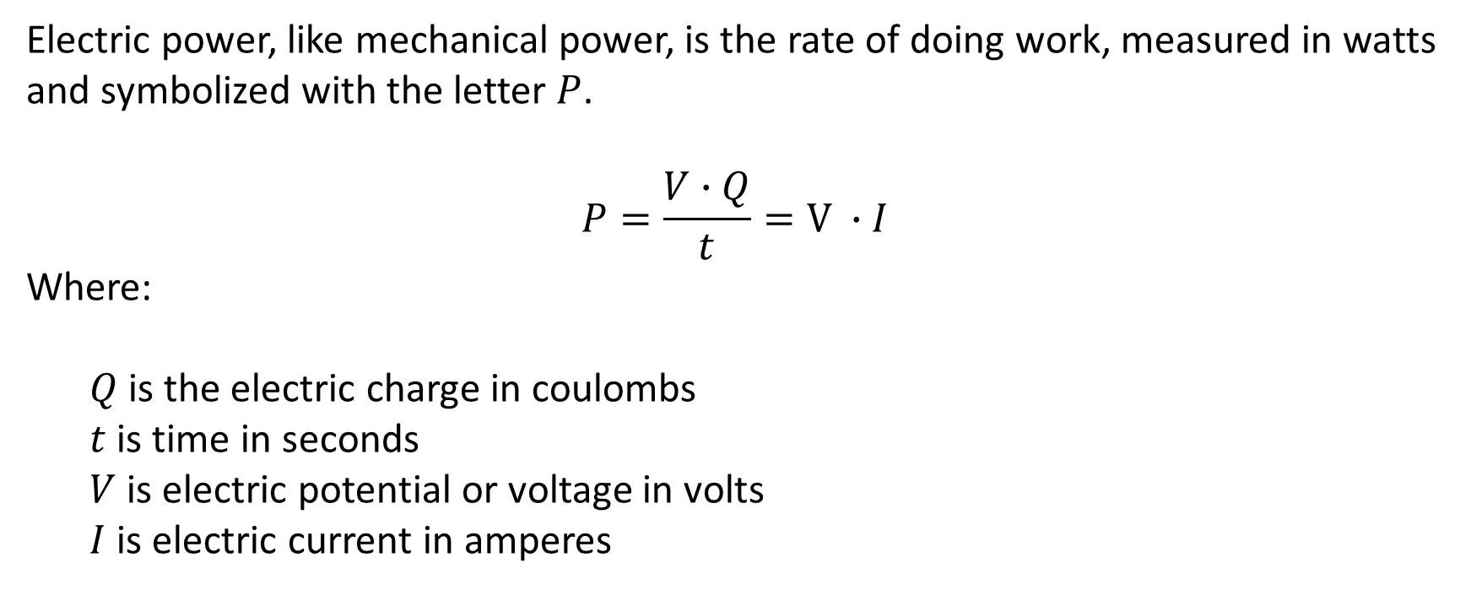
Watt’s Law
Electric power, like mechanical power, is the rate of doing work, measured in watts and symbolized with the letter $P$.
$$P=\frac{V∙Q}{t}=V ∙I$$
Where:
$Q$is the electric charge in coulombs $t$ is time in seconds
$V$ is electric potential or voltage in volts
$I$ is electric current in amperes

Slide 13
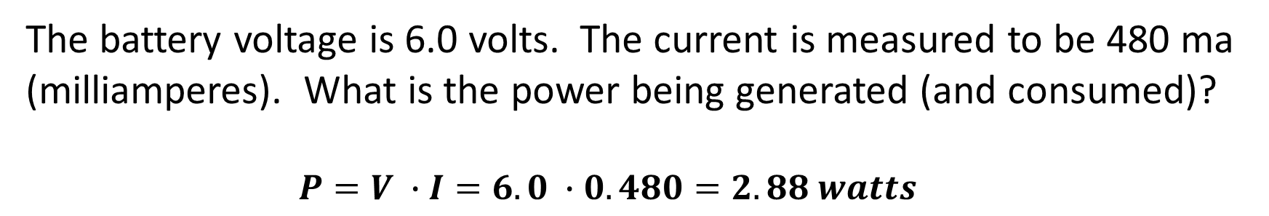
Watts’s Law Example
The battery voltage is 6.0 volts. The current is measured to be 480 ma (milliamperes). What is the power being generated (and consumed)?
$$P=V ∙I=6.0 ∙0.480=2.88 watts$$

Slide 14
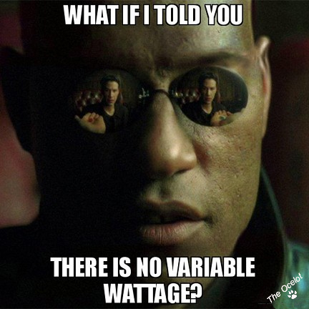
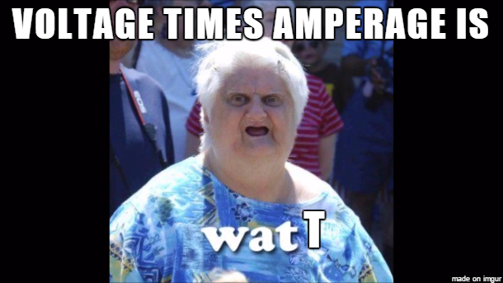

Watt’s Law: Points to Ponder

Slide 15
Electricity Must Obey the Law(s)
There are three “laws” that hold true for basic electrical circuits: Ohm’s Law, Voltage Law and Current Law. Other relationships can be derived from these three laws.
These laws are useful in designing and analyzing electrical circuits. For instance, using these laws, it’s possible to determine how resistors behave in combination:
Resistor Combinations Resistors in Series and Parallel

Slide 16
Magnetism

Slide 17
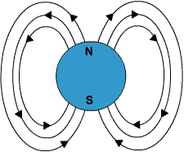
What is Magnetism?
Magnetism is a force of attraction or of repulsion that acts at a distance. It is due to a magnetic field, which is caused by moving electrically charged particles. It is also inherent in ferromagnetic materials such as iron, nickel and cobalt.
A magnetic field consists of imaginary lines of flux coming from moving or spinning electrically charged particles. Examples include the spin of a proton and the motion of electrons through a wire in an electric circuit.

Slide 18
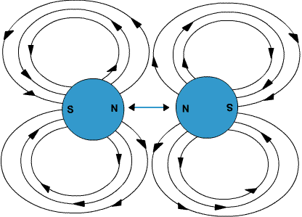
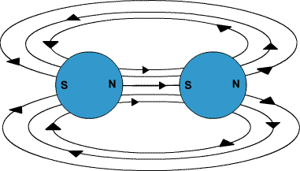
Magnetic Force
Attraction
When two magnets or magnetic objects are close to each other, there is a force that attracts the opposite poles together.
Repulsion
When two magnetic objects have like poles facing each other, the magnetic force pushes them apart.

Slide 19
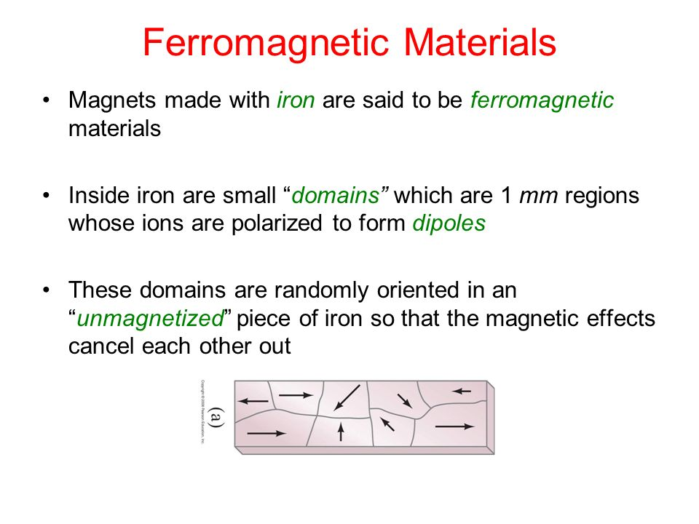

Slide 20
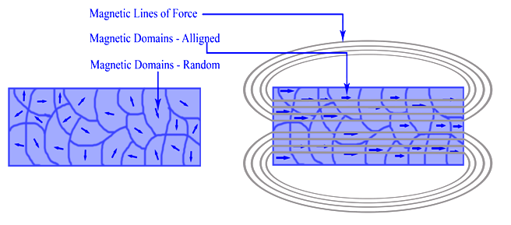
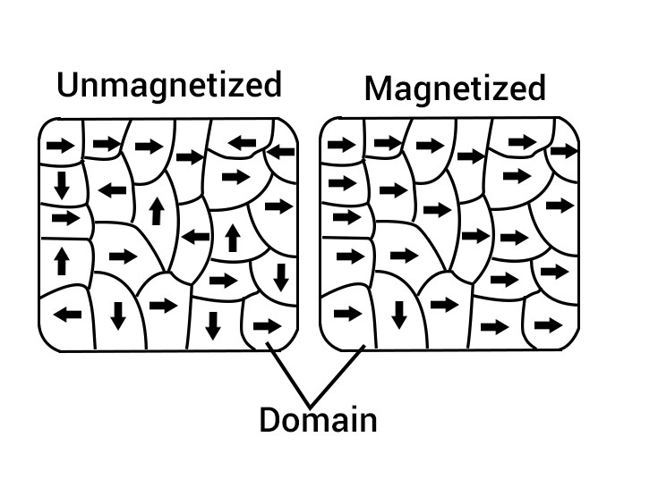
Magnetic Domain Alignment
An applied external magnetic field, over time, can cause the magnetic dipoles to align in the same direction, creating a net N-S magnetic field which remains when the external field is removed.

Slide 21
Magnetic and Electric Fields
Similarities
Just as the positive (+) and negative (−) electrical charges attract each other, the N and S poles of a magnet attract each other.
In electricity like charges repel, and in magnetism like poles repel.
Differences
The magnetic field is a dipole field. That means that every magnet must have two poles.
On the other hand, a positive (+) or negative (−) electrical charge can stand alone. Electrical charges are called monopoles, since they can exist without the opposite charge.

Slide 22
Electric and Magnetic Field Relationship
Moving charge (i.e., electrical current) produces a magnetic field perpendicular to the electric field.
A change in current produces a fluctuation in the associated magnetic field.
A moving magnetic field produces a current in a conductor perpendicular to the magnetic field movement.
A fluctuation in the magnetic field produces a change in the associated current.
The moving current and/or fluctuating magnetic field produces a force which is perpendicular to the plane of both.
This relationship is referred to as electromagnetism.

Slide 23
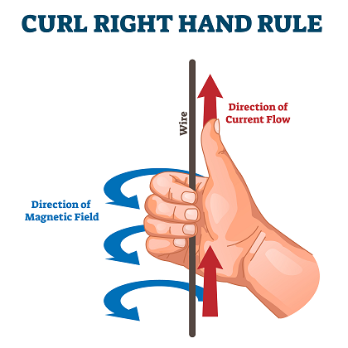
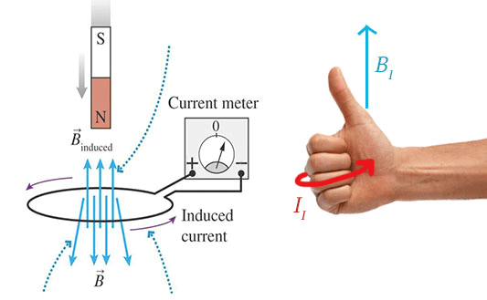
Curl Right Hand Rules

Slide 24
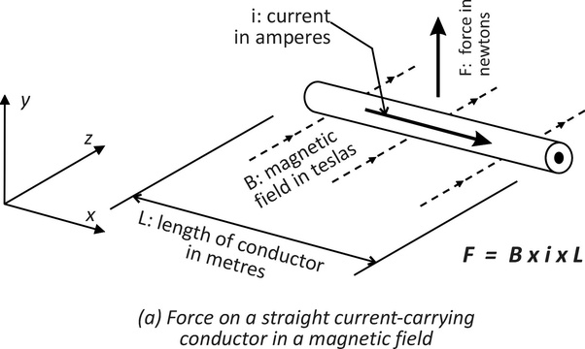
Lorentz Force Rule

Slide 25
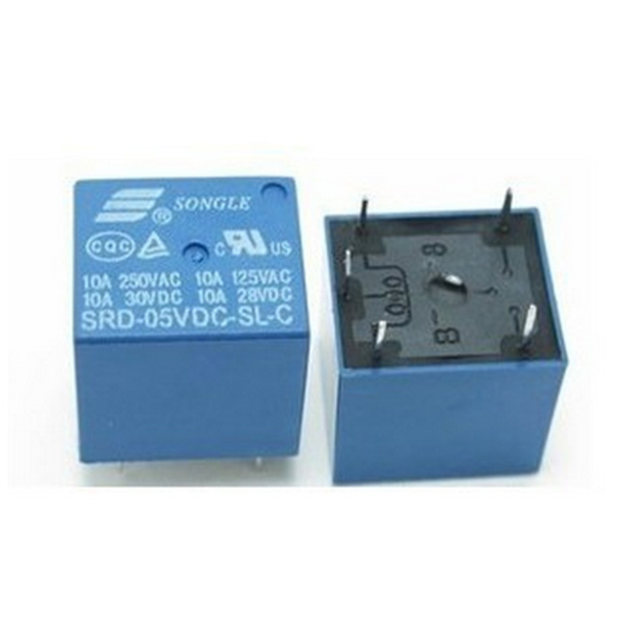
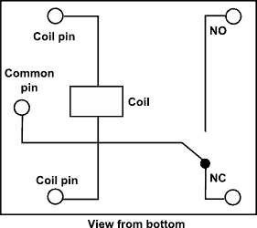
Electromagnetic Relay (Part 1)

Slide 26
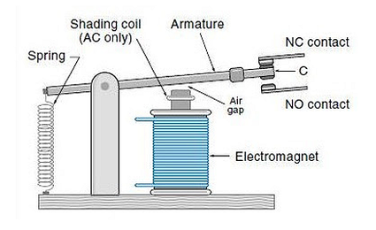
Electromagnetic Relay (Part 2)

Slide 27
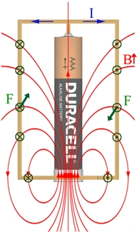
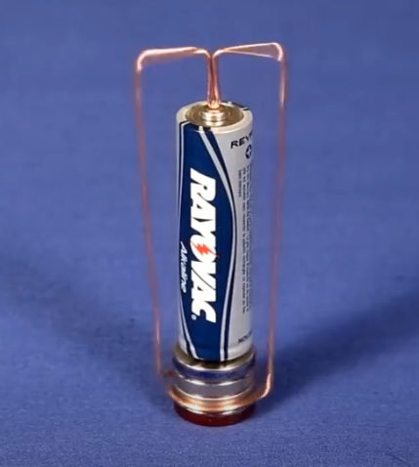
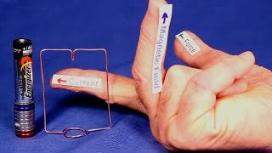
DC Motors - Homopolar
Homopolar Motor Video

Slide 28
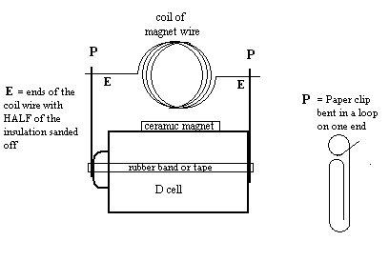
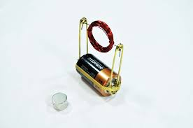
DC Motors - Commutator
Simple Commutator Motor Video

Slide 29
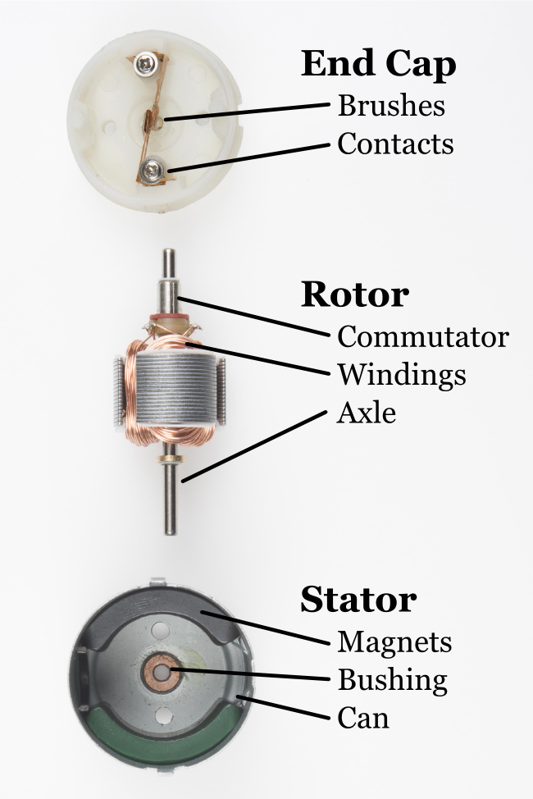
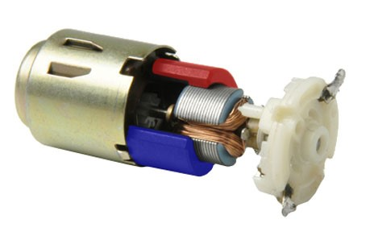
DC Motors - Commutator
Falstad DC Motor Simulation

Slide 30
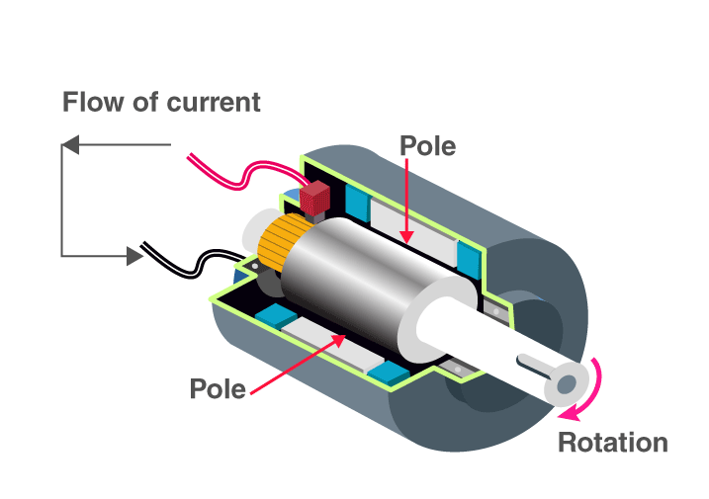
DC Generators
Falstad DC Generator Simulation

Slide 31
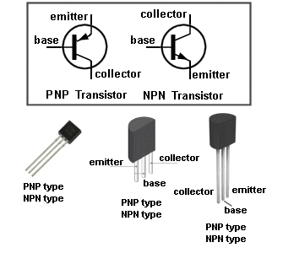
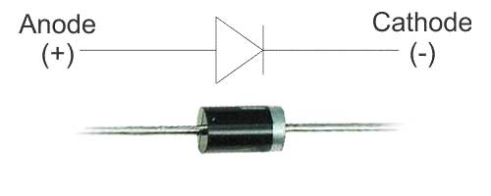
Semiconductor
A substance having conductivity between that of an insulator and that of most metals, either due to the addition of an impurity or because of temperature effects.
Diode

Slide 32
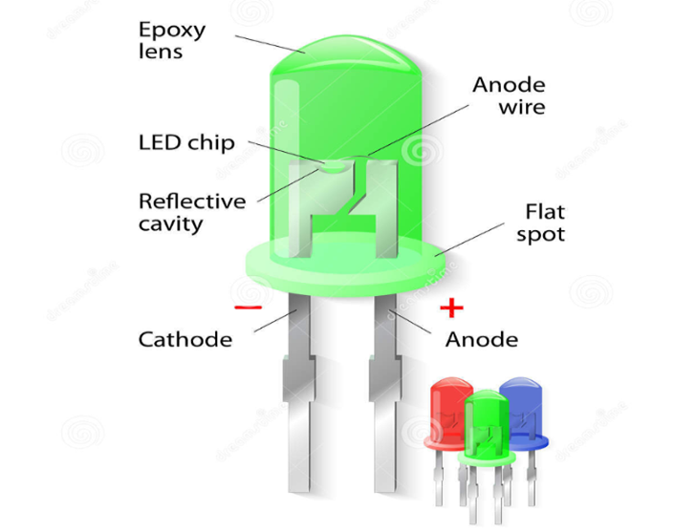
LED – Light Emitting Diode

Slide 33
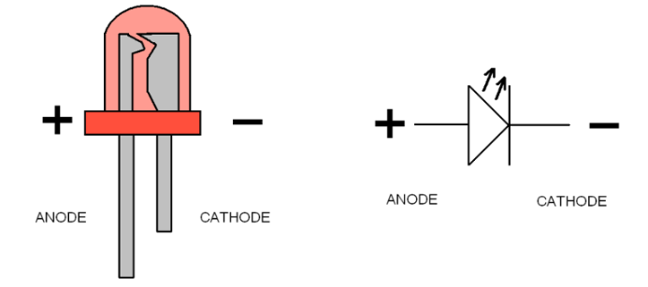
LED – Connections
Light is emitted only when electricity flows from anode (+) to cathode (-). An LED is a diode because it will NOT allow current to flow the other direction.

Slide 34
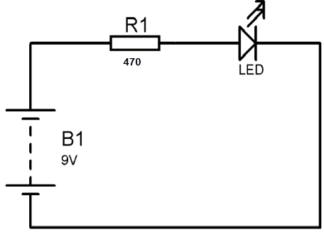
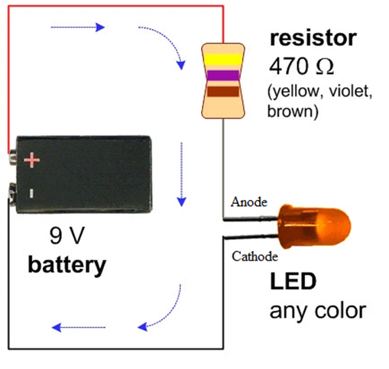
LED Circuit
The resistor limits the amount of current flowing so the LED is not damaged.

Slide 35
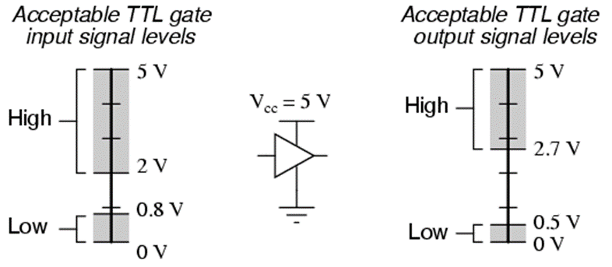
Digital Logic Levels
Most digital logic circuits are in only two states (LOW and HIGH). Zero to 0.7 volts registers as being in the LOW (logic 0) state and 2 to 5 volts registers as being in the HIGH (logic 1) state.

Slide 36
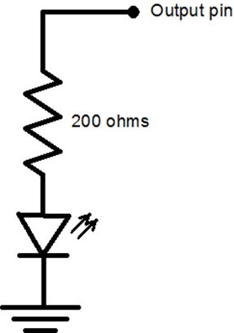
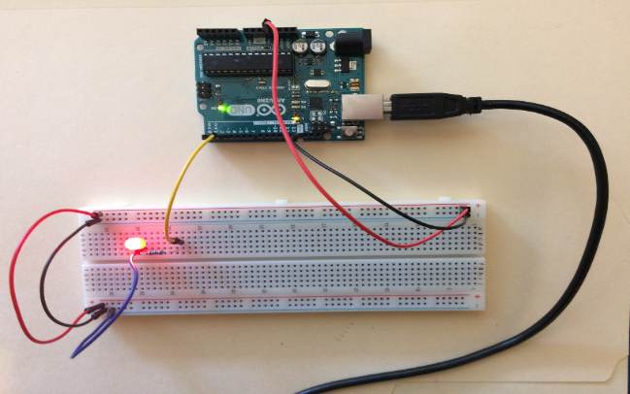
Red LED Output Circuit - Active HIGH
When output pin is HIGH (i.e. logic 1, or +4.8 volts), the LED anode is +2.1 volts and the cathode is 0 volts, so current (13.5 ma) flows through the LED and it emits light.

Slide 37

Exercise: Active HIGH LED (Breadboard)

Slide 38

Blue LED Output Circuit - Active LOW
When output pin is LOW (i.e. logic 0, or 0.0 volts), the LED anode is +3.4 volts and the cathode is 0.25 v, so current (8 ma) flows through the LED and it emits light.

Slide 39

Exercise: Active LOW LED (Breadboard)

